Slide 1

Law Merit Badge
Troop 344 and 9344
Pemberville, OH

Slide 2
Law Merit Badge Requirements
Define "law." Tell some of its sources. Describe functions it serves.
Discuss TWO of the following:
  The Justinian Code, The Code of Hammurabi, and the Magna Carta.
  The development of the jury system.
  Two famous trials in history.
Tell what civil law is; tell what criminal law is. Tell the main differences between them. Give examples of each.

Slide 3
Law Merit Badge Requirements
Ask five people (not more than one from your immediate family) about the role of law enforcement officers in our society. Discuss their answers with them. Report your findings to your counselor.
Tell about several laws that were passed to protect the consumer and the seller. Tell about several organizations that provide help to consumers and sellers.
Do ONE of the following:
  Attend a session of a civil or criminal court. Write 250 words or more on what you saw.
  Plan and conduct a mock trial with your troop or school class. After the trial is over, discuss it with the group.

Slide 4
Law Merit Badge Requirements
Arrange a visit with a lawyer who works for a business, bank, title company, or government agency. Find out his or her duties and responsibilities. Report what you learned.
Explain the requirements for becoming a lawyer in your state. Describe how judges are selected in your state.
Make a list of 15 jobs which deal with some aspect of law or legal processes. Tell which you prefer. Why?
Tell where people can go to obtain the help of a lawyer if they are unable to pay for one. Tell what you can do if you can afford a lawyer but do not know of any in your area.

Slide 5
Law Merit Badge Requirements
Discuss with your counselor the importance in our society of TWO of the following areas of the law or process:
  Administrative
  Alternative Dispute Resolution
  Bankruptcy
  Biotechnology
  Environmental
  Family
  Immigration
  Information Technology
  Intellectual Property, (Copyright, Patents and Trademarks)
  International
  Privacy.

Slide 6
Requirement 1
Define "law." Tell some of its sources. Describe functions it serves.

Slide 7
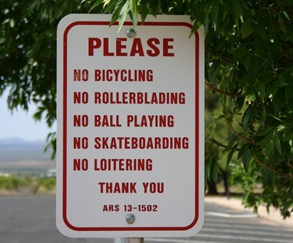
Law and Its Functions
Law can be defined as a system of rules and guidelines, usually enforced through a set of institutions.
It generally serves to protect individual rights and freedoms, regulate societal behavior, maintain order and security, resolve disputes, and promote social justice and equality.

Slide 8
Sources of Law
Source of Law | Description
Constitutions | The fundamental laws of a nation or a state that establish the character and structure of its government and the basic principles to which society must conform.
Statutes | Laws enacted by legislative bodies at any level of government, such as Congress, state legislatures, and city councils.
Regulations | Rules made by government agencies to implement and enforce statutory law.
Case Law | Also known as common law or judicial precedent, these are laws that come from decision making in courts when judges issue rulings and interpretations.
International Law | Laws governing relations between nations and international organizations. This includes treaties and conventions.
Customs and Traditions | Long-standing practices and traditions can also have legal force in certain jurisdictions or situations.

Slide 9
Requirement 2
Discuss TWO of the following:
  The Justinian Code, The Code of Hammurabi, and the Magna Carta.
  The development of the jury system.
  Two famous trials in history.

Slide 10
The Code of Hammurabi
The Code of Hammurabi was one of the earliest and most complete written legal codes and was proclaimed by the Babylonian king Hammurabi, who reigned from 1792 to 1750 B.C.
  He set up a system of law to apply everywhere in his empire.
  It divided the King’s subjects into three classes, free citizens with full civil rights, ordinary citizens with fewer rights, and slaves.
  It included economic provisions (prices, tariffs, trade, and commerce), family law (marriage and divorce), criminal law (assault, theft), and civil law (slavery, debt).
  It included many harsh punishments, sometimes demanding the removal of the guilty party's tongue, hands, breasts, eye or ear.
  The code is also one of the earliest examples of an accused person being considered innocent until proven guilty.

Slide 11
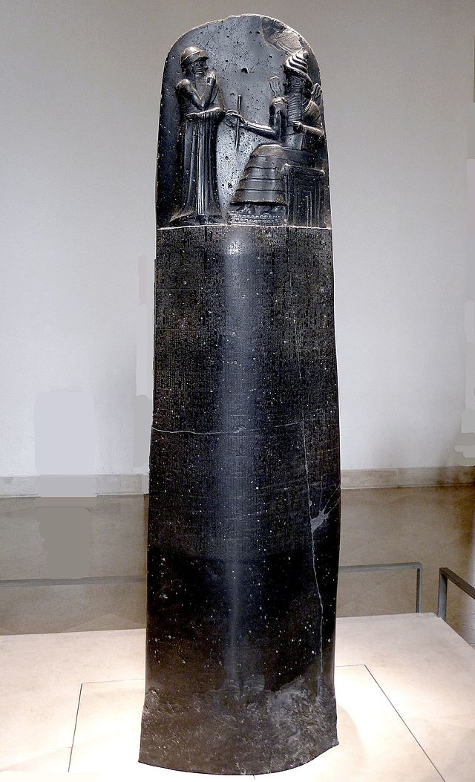
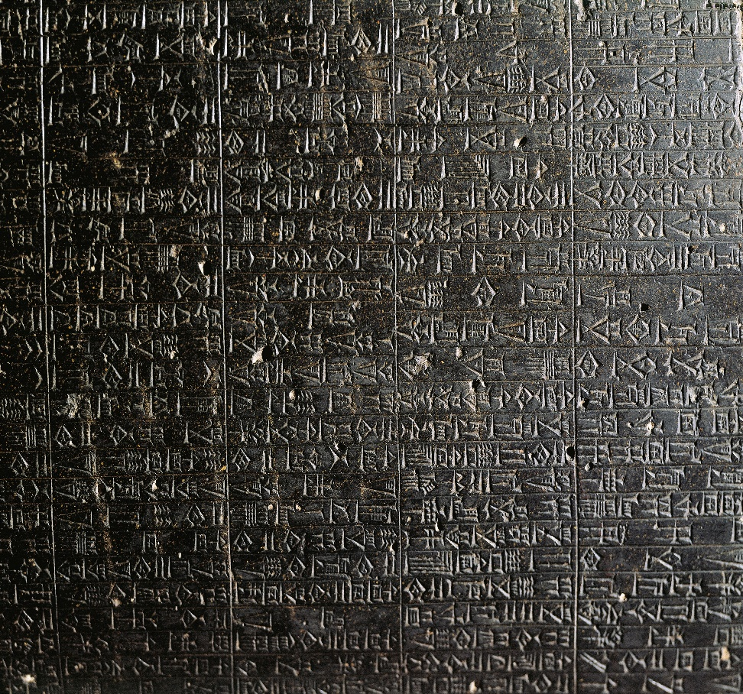
The Code of Hammurabi Stele

Slide 12
The Justinian Code
Code of Justinian was a collection of laws and legal interpretations developed under the sponsorship of the Byzantine emperor Justinian I from 529 to 565 AD.
  The laws of the time were collected, updated, and placed in order by subject (codification) so they could easily be looked up.
  People became more sure what the laws were and had a better chance for justice.
  Justinian also made certain that new laws were published to keep the code up-to-date.
  Justinian’s Roman laws formed the basis of civil law and is considered the foundation of much of Western legal thought.

Slide 13
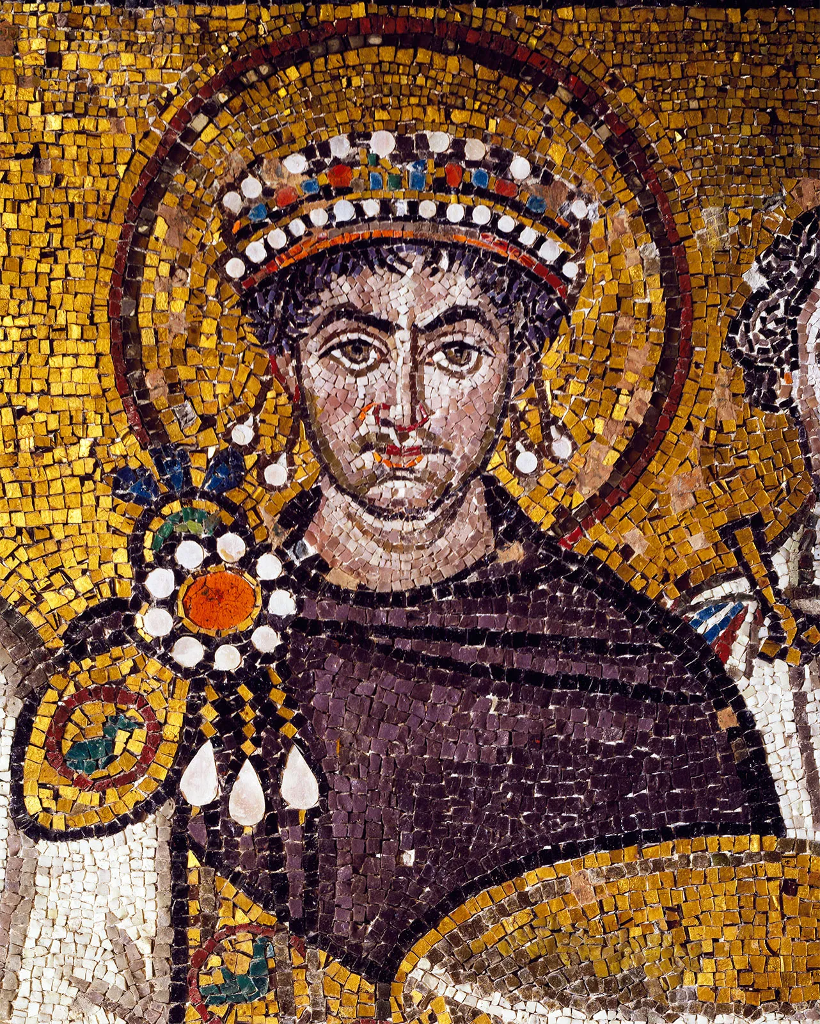

The Justinian Code

Slide 14
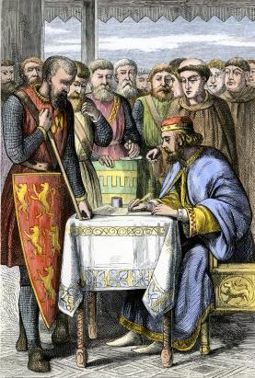
The Magna Carta
The Magna Carta was a charter of English liberties granted by King John on June 15, 1215 under threat of civil war.
  The Magna Carta is considered a foundational document in the development of constitutional law.
  It introduced the concept of rule of law, where even the monarchy was not above the law.
  Many of its principles, such as habeas corpus and trial by jury, remain central to modern legal systems.

Slide 15
Requirement 2
Discuss TWO of the following:
  The Justinian Code, The Code of Hammurabi, and the Magna Carta.
  The development of the jury system.
  Two famous trials in history.

Slide 16
Development of the Jury System
In the 6th century B. C., designated Greek citizens tried and passed judgment on questions of law.
The Greek system evolved into Rome’s Judices by the 4th century B. C.
  It was this system that was most likely the first form of juries in England having arrived on British shores with the Roman Conquest.
By the late 800s, under the leadership of Alfred the Great, trial by a jury of one’s peers became the norm throughout England and is considered as the start of the modern jury system.
In 1215 the Magna Carta affirmed that trial by jury would be the standard for all subjects of the English – and later British – crown.

Slide 17
Development of the Jury System (continued)
In the early 1600s British subjects began sailing for America and the rights that they had been guaranteed in the Magna Carta, including trial by jury, were reasserted in the colonial charters.
In 1776, in our Declaration of Independence America’s founding fathers made trial by jury a right.
The 4th, 5th, 6th, and 7th Amendments of the Bill of Rights outlines the rights to a fair and speedy trial, the right to confront witnesses, the right to counsel, accused persons in criminal trials do not have to testify, and the right to trial by jury in specified cases.
These amendments, combined with statutes and laws established by court decisions make up the rights and procedures guaranteed to all Americans in court.

Slide 18
Requirement 2
Discuss TWO of the following:
  The Justinian Code, The Code of Hammurabi, and the Magna Carta.
  The development of the jury system.
  Two famous trials in history.

Slide 19
Brown v. Board of Education (1954)
Issue: Do racially segregated public schools violate the Equal Protection Clause?
Result: Yes. A unanimous Court overturned Plessy v. Ferguson and held that state laws requiring or allowing racially segregated schools violate the Equal Protection Clause of the Fourteenth Amendment. The Court famously stated "separate educational facilities are inherently unequal.“
Importance: The Brown decision is heralded as a landmark decision in Supreme Court history, overturning Plessy v. Ferguson (1896) which had created the "separate but equal" doctrine. In Plessy, The Court held that even though a Louisiana law required rail passengers to be segregated based on race, there was no violation of the Fourteenth Amendment's Equal Protection Clause so long as the accommodations at issue were "separate, but equal." By overturning this doctrine, the Brown Court helped lay the ground for the civil rights movement and integration across the country.

Slide 20
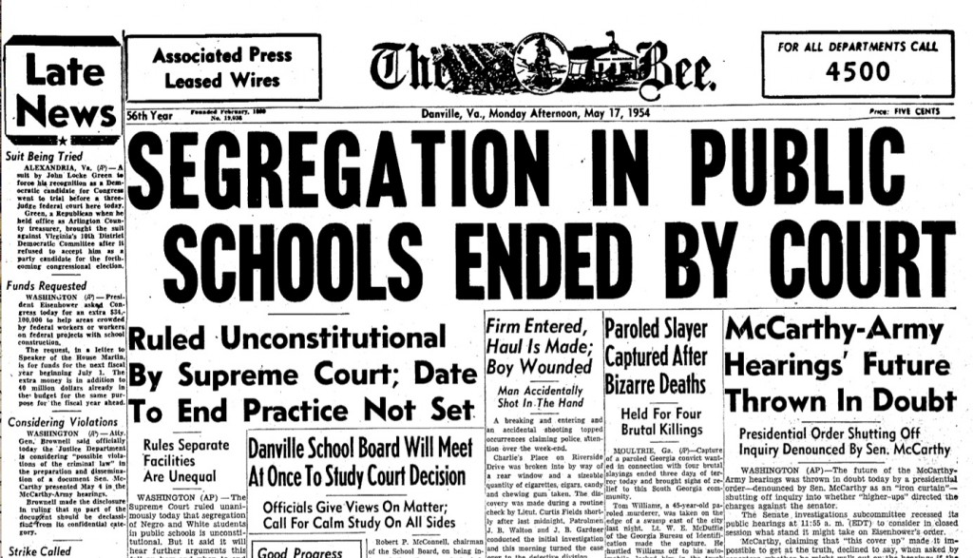
Brown v. Board of Education (1954)

Slide 21
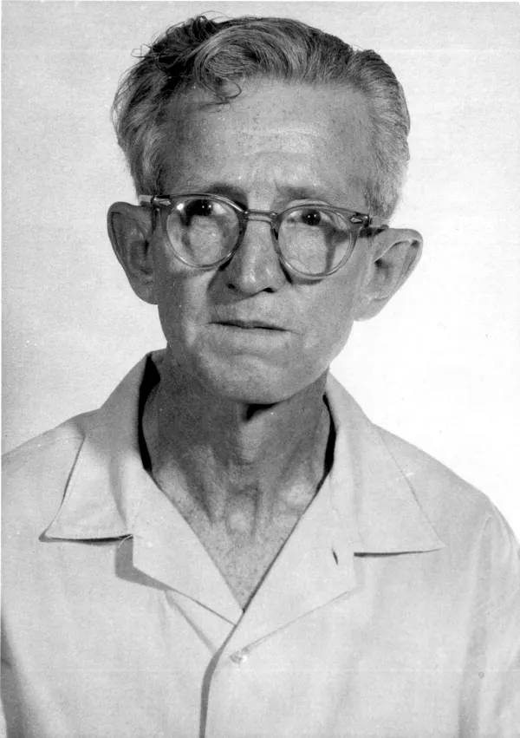
Gideon v. Wainwright (1963)
Issue: Does the Constitution require that any individual charged with a felony, but unable to pay for a lawyer, be guaranteed the free assistance of legal counsel?
Result: Yes, according to a unanimous Supreme Court. The Court held that the Sixth Amendment right to assistance of counsel applies to criminal state trials and that "lawyers in criminal court are necessities, not luxuries.“
Importance: Along with the right to assistance for state criminal defendants, the Gideon decision had the effect of expanding public defender systems across the country.

Slide 22
Miranda v. Arizona (1966)
Issue: Are police constitutionally required to inform people in custody of their rights to remain silent and to an attorney?
Result: Yes, the Court found that the Fifth and Sixth Amendments require police to inform individuals in custody that they have a right to remain silent and to be assisted by an attorney. According to the Court, if the police fail to do so, a criminal court judge may rule that any statements made by the accused cannot be admitted as evidence during trial.
Importance: The now famous "Miranda warnings" are required before any police custodial interrogation can begin if any of the evidence obtained during the interrogation is going to be used during a trial; the Court has limited and narrowed these warnings over the years.

Slide 23
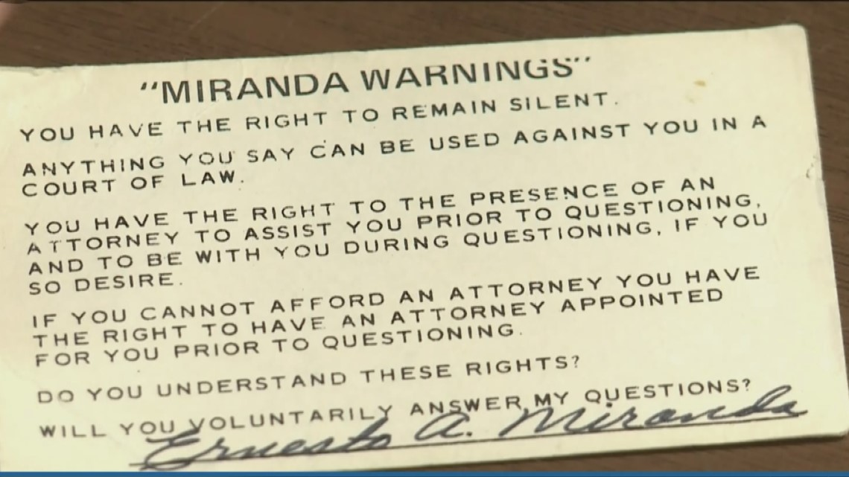
Miranda v. Arizona (1966)

Slide 24
Roe v. Wade (1973)
Issue: Does the Constitution prohibit laws that severely restrict or deny a woman's access to abortion?
Result: Yes. The Court concluded that such laws violate the Constitution's right to privacy. The Court held that, under the Fourteenth Amendment Due Process Clause, states may only restrict abortions toward the end of a pregnancy, in order to protect the life of the woman or the fetus.
Importance: Roe has become a center-piece in the battle over abortion-rights, both in the public and in front of the Court.

Slide 25
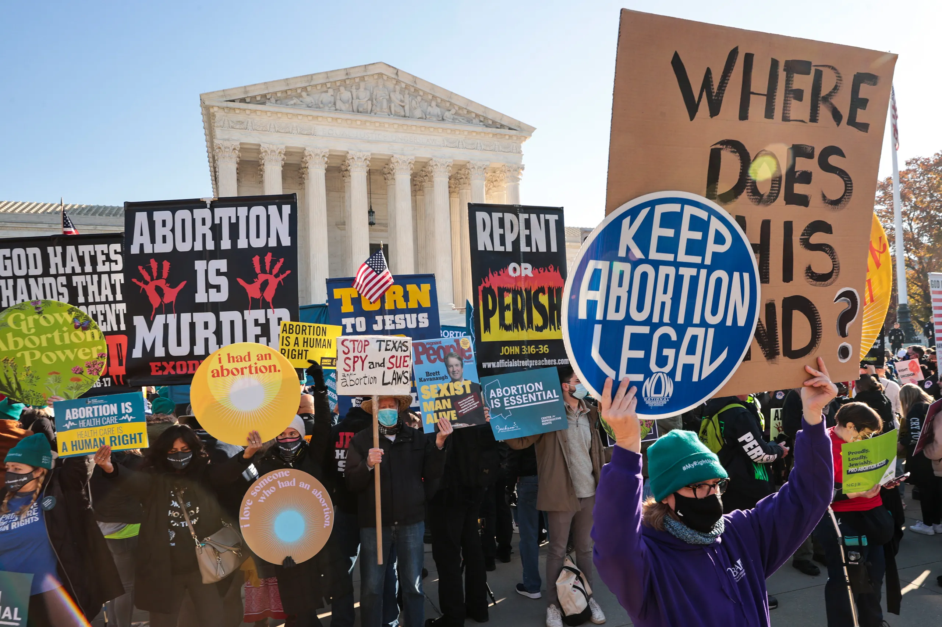
Roe v. Wade (1973)

Slide 26
Sheppard v. Maxwell (1966)
Issue: The balance between the 6th Amendment's guarantee of a fair trial and the 1st Amendment's freedom of the press.
Result: The Court found that the hostile trial coverage by Cleveland's radio and print media, and the physical arrangement of the courtroom itself - which facilitated collaboration between the prosecution and the media - all combined to so inflame the jurors' minds against Sheppard as to deny him a fair trial consistent with the 6th amendment and the Due Process Clause of the 14th Amendment.
Importance: Sheppard v. Maxwell was instrumental in changing laws around media involvement in criminal trials. This case showed how a circus-like “media” trial can pit freedom of the press against the right to a fair trial and how the Supreme Court can use concerns about the latter to put reasonable limits on the former. Sheppard v. Maxwell remains an important precedent for how media and court cases are handled today.

Slide 27

Sheppard v. Maxwell (1966)

Slide 28
Requirement 3
Tell what civil law is; tell what criminal law is. Tell the main differences between them. Give examples of each.

Slide 29
Civil Law versus Criminal Law
 | Civil Law | Criminal Law
Definition | Civil law governs disputes between individuals, organizations, or between the two. It primarily deals with private rights and obligations. | Criminal law pertains to crimes committed against the state, society, or public, even if the immediate victim is an individual.
Purpose | The purpose of civil law is to resolve disputes and provide compensation for someone injured by someone else’s acts or behavior. | The purpose of criminal law is to maintain law and order, protect society, and punish wrongful actions.
Legal Action Initiated By | Legal action is initiated by the injured party (the plaintiff). | Legal action is initiated by the state (prosecution).
Standard of Proof | The standard of proof is typically “preponderance of the evidence,” meaning it’s more likely than not that one party is responsible. | The standard of proof is “beyond a reasonable doubt,” a much higher standard, due to potential penalties like imprisonment.
Possible Outcomes | Outcomes in civil cases often involve monetary damages or injunctions to stop/proceed with certain behavior. | Outcomes in criminal cases can involve penalties like imprisonment, probation, fines, community service, or even capital punishment.

Slide 30
Civil Law versus Criminal Law
Examples of Civil Law Cases | Examples of Criminal Law Cases
Personal injury claims (e.g., car accidents) | Theft or burglary
Property disputes (e.g., boundary conflicts) | Assault and battery
Family law cases (e.g., divorces, child custody) | Drug possession or trafficking
Contract disputes (e.g., breach of contract) | Homicide

Slide 31
Requirement 4
Ask five people (not more than one from your immediate family) about the role of law enforcement officers in our society. Discuss their answers with them. Report your findings to your counselor.

Slide 32
Role of Law Enforcement in Society
Questions you could ask people about the role of law enforcement officers in our society:
  How would you describe the role of law enforcement officers in our society?
  Do you believe law enforcement officers are necessary for maintaining order?
  Can you share any positive or negative experiences you’ve had with law enforcement officers?
  What qualities do you think a good law enforcement officer should possess?
  How do you think the role of law enforcement officers could be improved?

Slide 33
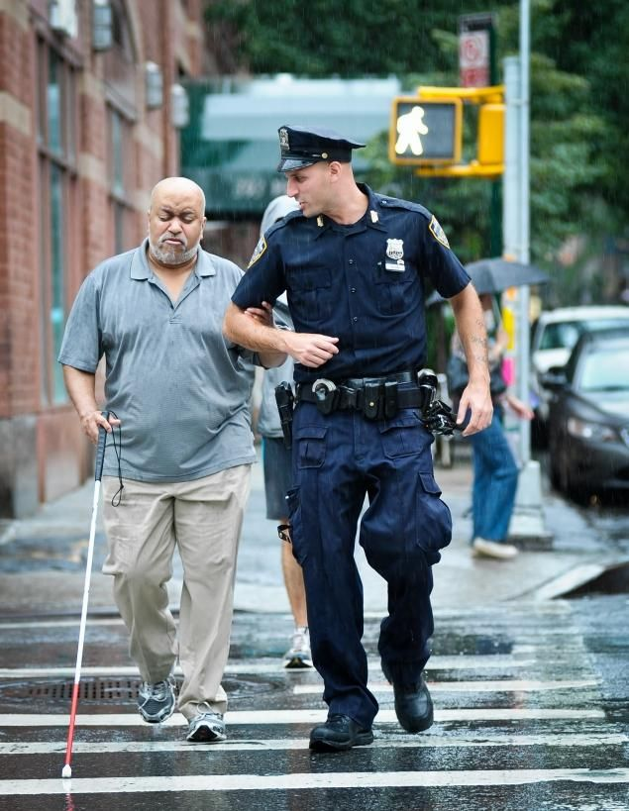
Role of Law Enforcement in Society
Questions you could ask a law enforcement officer about their responsibilities and duties:
  What are your primary responsibilities as a law enforcement officer?
  What does a typical day look like for you?
  What are the most challenging aspects of your job?
  What are the most rewarding aspects of your job?
  How do you manage the stress and pressure that comes with this job?

Slide 34
Requirement 5
Tell about several laws that were passed to protect the consumer and the seller. Tell about several organizations that provide help to consumers and sellers.

Slide 35
Laws Protecting Consumers and Sellers
Law | Protection for Consumers | Protection for Sellers
Federal Trade Commission Act (FTC) | Prohibits deceptive advertising and marketing practices. | Provides clear guidelines for businesses to understand what constitutes fair and unfair practices.
Consumer Product Safety Act (CPSA) | Regulates the sale and manufacture of consumer products to ensure they are safe from unreasonable risks of injury. | Gives guidelines for product safety, reducing potential liability for businesses.
Fair Debt Collection Practices Act (FDCPA) | Protects consumers from abusive, unfair, or deceptive practices by debt collectors. | Defines acceptable conduct, protecting ethical debt collectors from unfounded accusations.
Uniform Commercial Code (UCC) | Ensures fair trade practices in sales and commercial transactions. | Provides a standardized set of laws to govern commercial transactions across different states.

Slide 36
Organizations Helping Consumers and Sellers
Federal Trade Commission (FTC): The FTC protects consumers by stopping unfair, deceptive, or fraudulent practices in the marketplace. It also provides information to businesses about their responsibilities and obligations.
Better Business Bureau (BBB): The BBB helps consumers find trustworthy businesses and avoid scams. It also offers dispute resolution services and provides businesses with accreditation that signals trust to consumers.
Consumer Financial Protection Bureau (CFPB): The CFPB ensures that consumers are treated fairly by banks, lenders, and other financial institutions. It also provides guidelines to these institutions for fair practices.

Slide 37
Organizations Helping Consumers and Sellers
National Association of Consumer Advocates (NACA): The NACA is a nonprofit association of attorneys and consumer advocates committed to representing consumers’ interests. It provides a platform for sharing information about consumer protection issues.
Chambers of Commerce: Local and national chambers of commerce support businesses by providing resources, advocacy, and networking opportunities. They also promote ethical business practices which in turn protect consumers.
National Federation of Independent Business (NFIB): The NFIB advocates for small and independent businesses, offering resources and legal assistance to its members while also advocating for policies that protect consumers.

Slide 38
Requirement 6
Do ONE of the following:
  Attend a session of a civil or criminal court. Write 250 words or more on what you saw.
  Plan and conduct a mock trial with your troop or school class. After the trial is over, discuss it with the group.

Slide 39
Access to Ohio Court Proceedings
Note: This page covers information specific to Ohio.
You have a right to attend most court proceedings in Ohio state courts.
  However, your right of access is not absolute, and a court can restrict your access under certain circumstances.
  If you are interested in attending a court proceeding, visit the Ohio judiciary's website to find the locations, phone numbers, and websites for the state's courts by county.
  This website focuses on your ability to access certain types of proceedings.

Slide 40
Requirement 6
Do ONE of the following:
  Attend a session of a civil or criminal court. Write 250 words or more on what you saw.
  Plan and conduct a mock trial with your troop or school class. After the trial is over, discuss it with the group.

Slide 41
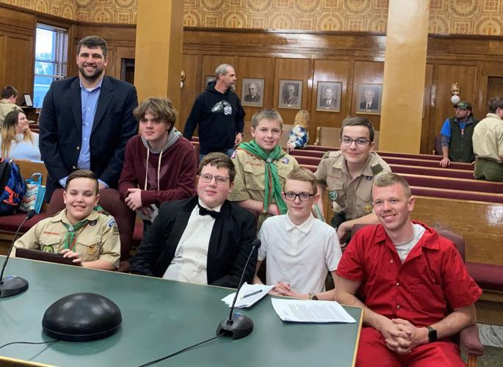
Mock Trials
Mock trials can help youth develop an understanding of the people in the courtroom and their functions, the importance of rules in insuring fairness of the proceeding, and the importance of witnesses and jurors in determining the facts of the case.

Slide 42
Planning the Mock Trial
Choose a Case: First, you need to select a case for your mock trial. This can be a simplified version of a real-life case or one of the four Mini Mock Trials included with this presentation (see next slide). The case should include a clear conflict, identifiable roles, and enough complexity to facilitate a meaningful discussion.
Roles: Assign roles to the participants. These roles can include judge, prosecution, defense, witnesses, and jury. Each participant should be given a detailed description of their character and the facts they need to know.
Preparation: Allow the participants time to prepare for the trial. The prosecution and defense should prepare opening and closing statements, questions for witnesses, and responses to potential arguments. The witnesses should understand their testimony and how to respond to questions.

Slide 43
Mini Mock Trials
Mini Mock Trials to choose from:
  Mini Mock Trial Instruction Manual – Read this first!!
  Mini Mock Trial State v. Alli - (Alli is charged with possession of marijuana found in her recently purchased used backpack)
  Mini Mock Trial State v. Anderson - (Driver charged with failing to move a lane away from stopped emergency vehicle)
  Mini Mock Trial State v. Max Paulson - (reckless driving charge in a automobile and bicycle accident)
    State v. Max Paulson Diagram
  Mini Mock Trial State v. Toni - (a broken window is caused by a rock that is thrown by neighborhood children)

Slide 44
Discussing the Mock Trial
After the trial, facilitate a discussion with the group. Here are some questions you can use to guide the discussion:
  What did you learn from the trial about the legal process?
  Do you agree with the verdict? Why or why not?
  Was there any evidence or argument that you found particularly compelling?
  How could the prosecution or defense have improved their case?
  How did it feel to play your assigned role?
  What are some real-world implications of the issues raised in the trial?
This mock trial can provide participants with a hands-on understanding of the legal process and foster skills like public speaking, critical thinking, and teamwork.
Remember, the goal is not just to win the case, but to learn about the legal system.

Slide 45
Requirement 7
Arrange a visit with a lawyer who works for a business, bank, title company, or government agency. Find out his or her duties and responsibilities. Report what you learned.

Slide 46
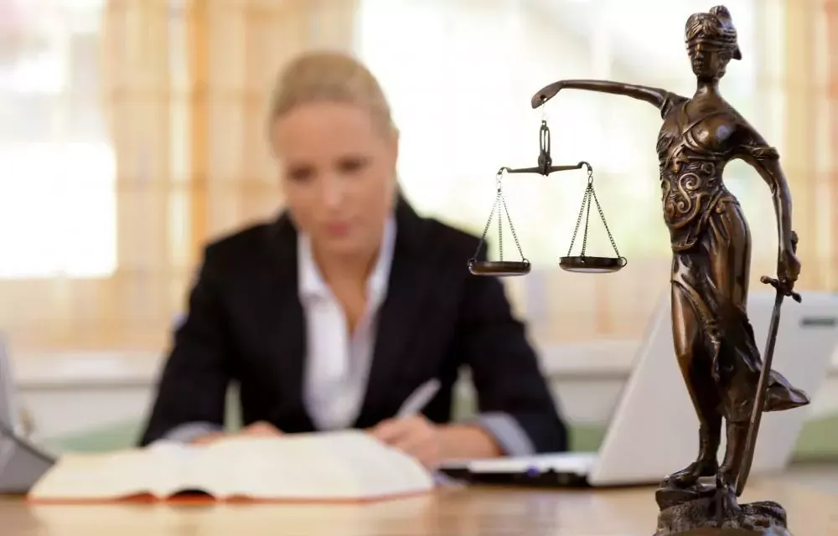
Meeting with a Lawyer
Step 1 – Arrange a Visit: Contact local businesses, banks, title companies, or government agencies and request a meeting with one of their lawyers. You can do this via email, phone, or a formal letter.

Slide 47
Meeting with a Lawyer
Step 2 – Prepare Questions: Prepare a list of questions to ask during the meeting. Here are some examples:
  What is your job title and what does your role entail?
  Can you describe a typical day at work?
  What kind of legal issues do you commonly deal with?
  What is the most challenging aspect of your job?
  What is the most rewarding aspect of your job?
  How did you decide to become a lawyer?
  What education and skills are necessary for your job?

Slide 48

Meeting with a Lawyer
Step 3 – Conduct the Visit: During the visit, be respectful and professional. Ask your prepared questions and take notes on their responses. Be curious and ask follow-up questions if you need clarity or want to explore a topic further.

Slide 49
Meeting with a Lawyer
Step 4 – Report Your Findings: After the visit, compile your notes into a report. Your report might look something like the following:
  Title: Visit with a Corporate Lawyer at XYZ Bank
  Duties and Responsibilities:
    Providing Legal Advice: The lawyer provides legal advice to different departments within the bank. This could be related to contracts, employment law, regulatory compliance, or any other legal issues that arise.
    Reviewing Contracts: The lawyer spends a lot of time reviewing and drafting contracts. This ensures that the bank’s interests are protected and that they are in compliance with all relevant laws and regulations.
    Managing Disputes: If there are any legal disputes involving the bank, the lawyer helps to manage them. This could involve negotiation, litigation, or other dispute-resolution processes.
    Regulatory Compliance: The lawyer helps the bank navigate various banking regulations. They work closely with the compliance department to ensure that the bank is following all necessary laws and regulations.

Slide 50
Meeting with a Lawyer
Step 4 – Report Your Findings (continued):
  Reflections: The visit provided valuable insight into the role of a lawyer in a corporate setting. I was particularly struck by the breadth of issues that the lawyer dealt with and how integral their role was in the functioning of the bank.
Remember to thank the lawyer for their time and the valuable information they shared. It may also be a good idea to send a follow-up thank you note after your visit.

Slide 51
Requirement 8
Explain the requirements for becoming a lawyer in your state. Describe how judges are selected in your state.

Slide 52
Becoming a Lawyer
The general steps to becoming a lawyer in the United States are:
  Undergraduate Degree: A bachelor’s degree is required for admission into law school. There’s no required major, but courses in English, public speaking, government, history, economics, and mathematics can be helpful.
  Law School Admissions Test (LSAT): This standardized test is a requirement for admission into law schools accredited by the American Bar Association (ABA).
  Law School: You must earn a Juris Doctor (J.D.) degree from a law school accredited by the ABA. Law school generally lasts three years and includes courses such as constitutional law, contracts, property law, civil procedure, and legal writing.
  Bar Exam: After graduating from law school, you must pass the bar exam in the state where you plan to practice.
  Character and Fitness Assessment: Most states require a positive assessment of a candidate’s character and fitness before admission to the bar.
  Admission to the State Bar: Once the bar exam and character and fitness assessment are passed, you can apply for admission to the state bar.

Slide 53
Selection of Judges
The selection of judges varies by state and methods include:
  Partisan Elections: Judges are elected by the public and candidates are allowed to list their political affiliation on the ballot.
  Nonpartisan Elections: Judges are elected by the public, but candidates may not list their political affiliation on the ballot.
  Appointment by Governor or Legislature: Some states have their judges appointed by the governor, often from a list of candidates nominated by a commission. In other states, the legislature appoints judges.
  Merit Selection: A nominating commission provides a list of candidates to the governor, who then appoints a judge from this list. After serving an initial term, the judge may run in an uncontested retention election to remain in the position.

Slide 54
Requirement 9
Make a list of 15 jobs which deal with some aspect of law or legal processes. Tell which you prefer. Why?

Slide 55
Careers Involving Law
Attorney/Lawyer: Provides legal advice and represents clients in civil or criminal proceedings.
Judge: Presides over court proceedings, ensuring they are conducted fairly and according to the law.
Paralegal: Assists lawyers by conducting legal research, drafting documents, organizing files, and other tasks.
Legal Secretary: Provides administrative support to attorneys, such as scheduling, correspondence, and document preparation.
Law Clerk: Assists judges by conducting research, preparing legal documents, and performing other duties.
Legal Consultant: Offers specialized advice to organizations, typically on a contract basis.
Arbitrator/Mediator: Helps parties resolve disputes outside of court, often through negotiation or facilitated dialogue.
Court Reporter: Transcribes court proceedings, creating a verbatim written record.

Slide 56
Careers Involving Law (continued)
Compliance Officer: Ensures that organizations follow all applicable laws, regulations, and internal policies.
Legal Analyst: Conducts research and analysis on legal matters, often for media outlets, corporations, or law firms.
Probation Officer: Supervises offenders who have been placed on probation, ensuring they follow their probation conditions.
Forensic Scientist: Uses scientific techniques to gather and analyze evidence for legal cases.
Patent Agent/Attorney: Specializes in filing and prosecuting patent applications on behalf of inventors.
Bailiff: Ensures order and security in courtrooms.
Law Enforcement Officer: Enforces laws, protects life and property, and arrests individuals suspected of committing crimes.

Slide 57
Careers Involving Law
Each of these roles requires a different set of skills and interests, and they also vary greatly in terms of educational requirements, work environment, and day-to-day responsibilities.
You will need to do more research or even conduct informational interviews to learn more about the jobs that interest you.

Slide 58
Requirement 10
Tell where people can go to obtain the help of a lawyer if they are unable to pay for one. Tell what you can do if you can afford a lawyer but do not know of any in your area.

Slide 59
Obtaining Legal Assistance
If You Can’t Afford a Lawyer
  Public Defender’s Office: If you are accused of a crime and cannot afford a lawyer, you have the right to a public defender. These are government-employed attorneys who represent clients unable to pay for counsel in criminal cases.
  Legal Aid Societies: Legal Aid organizations provide free legal services to low-income individuals. They can assist with various civil matters such as housing, family law, and employment issues.
  Pro Bono Programs: Many local bar associations and law schools have pro bono programs where lawyers volunteer their time to provide free legal services to those in need.
  Law School Clinics: Some law schools offer free or low-cost legal clinics where law students, supervised by their professors, can provide legal assistance.

Slide 60
Obtaining Legal Assistance
If You Can Afford a Lawyer but Don’t Know Any
  Local Bar Association: Most local bar associations have referral services that can connect you with attorneys in your area.
  Online Directories: Online legal directories like Avvo.com, Martindale-Hubbell.com, or the American Bar Association directory can help you find a lawyer based on your location and the type of legal help you need.
  Recommendations: Ask friends, family, or professional contacts if they can recommend a lawyer.
  Legal Plans: Consider a prepaid legal plan, where for a monthly or annual fee, you have access to a network of attorneys who can provide legal advice and representation.

Slide 61
Requirement 11
Discuss with your counselor the importance in our society of TWO of the following areas of the law or process:
  Administrative
  Alternative Dispute Resolution
  Bankruptcy
  Biotechnology
  Environmental
  Family
  Immigration
  Information Technology
  Intellectual Property, (Copyright, Patents and Trademarks)
  International
  Privacy.

Slide 62
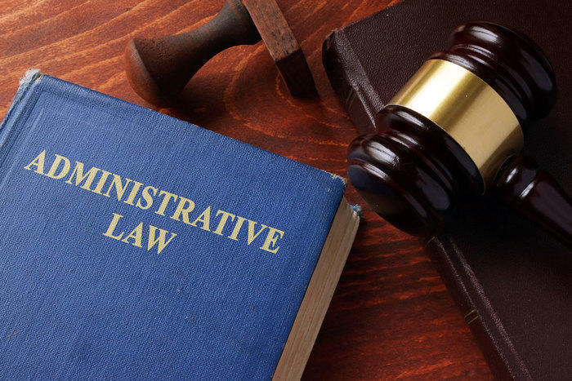
Administrative Law
Administrative law governs how government agencies operate and enforce regulations.
It ensures fair processes in issuing licenses, enforcing safety standards, and managing public programs like Social Security and environmental protection.
This law protects citizens from unfair government actions and ensures agencies act within their legal authority.

Slide 63
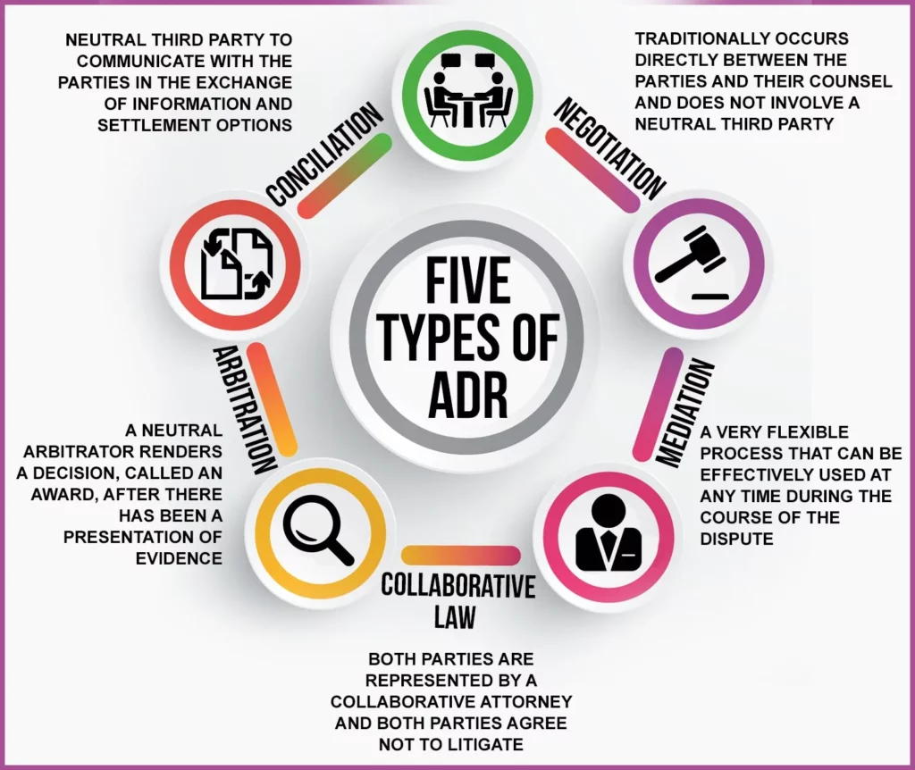
Alternative Dispute Resolution (ADR)
ADR includes mediation and arbitration, providing ways to settle disputes outside of court.
It helps individuals and businesses resolve conflicts efficiently, saving time and money.
ADR promotes cooperation, reduces court backlogs, and is often less stressful than traditional litigation.

Slide 64

Bankruptcy Law
Bankruptcy law provides relief to individuals and businesses struggling with overwhelming debt.
It allows them to restructure or discharge debts legally, offering a fresh financial start while ensuring fair treatment of creditors.
This law maintains economic stability by giving struggling businesses a chance to recover.

Slide 65

Biotechnology Law
Biotechnology law regulates medical and agricultural innovations, such as genetic engineering, pharmaceuticals, and bioethics.
It ensures new technologies are developed safely, protecting public health and balancing scientific progress with ethical considerations.

Slide 66

Environmental Law
Environmental law protects natural resources, wildlife, and human health by regulating pollution, land use, and conservation efforts.
It ensures sustainable development, holds companies accountable for environmental damage, and promotes clean air, water, and land for future generations.

Slide 67
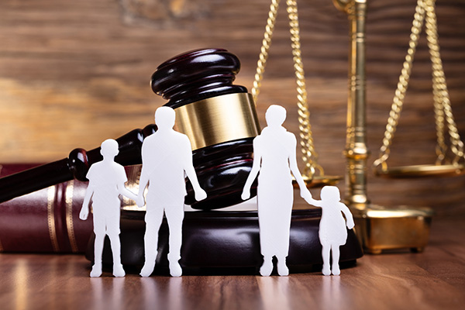
Family Law
Family law governs issues like marriage, divorce, child custody, and adoption.
It helps resolve conflicts fairly, ensuring the well-being of children and families.
This area of law provides legal protections for vulnerable individuals and helps maintain social order.

Slide 68
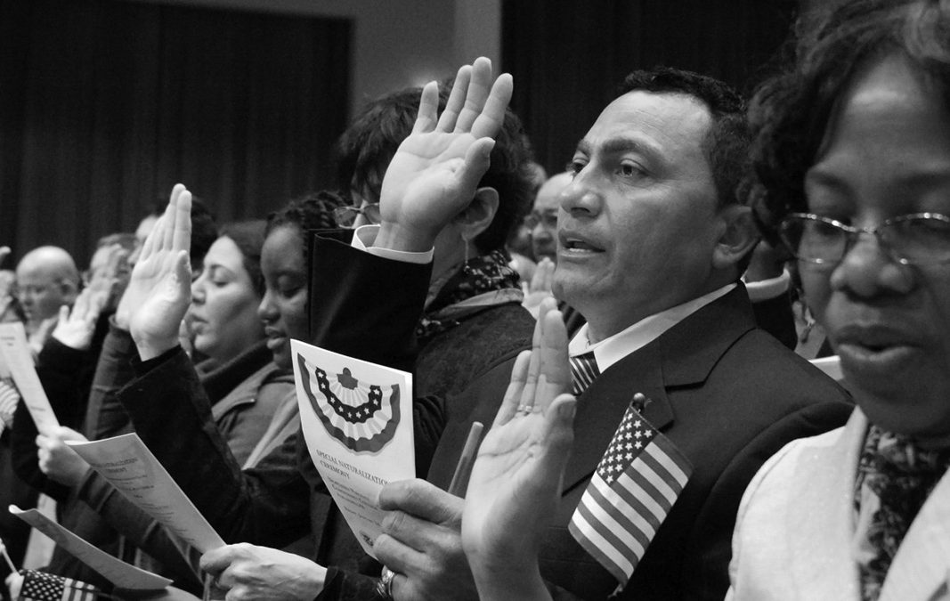
Immigration Law
Immigration law determines who can enter, stay, and become citizens of a country.
It balances national security, economic needs, and humanitarian concerns, ensuring that immigrants contribute to society while maintaining legal entry processes.

Slide 69

Information Technology (IT) Law
IT law governs digital transactions, cybersecurity, and online privacy.
As technology advances, this law protects individuals and businesses from cyber threats, fraud, and data breaches, ensuring ethical and legal use of technology.

Slide 70

Intellectual Property, (Copyright, Patents and Trademarks) Law
Intellectual property (IP) law protects creative works, inventions, and brand identities.
Copyright laws safeguard books, music, and art, while patents protect new inventions, and trademarks protect brand names.
These laws encourage innovation and economic growth by ensuring creators and inventors receive fair compensation.

Slide 71
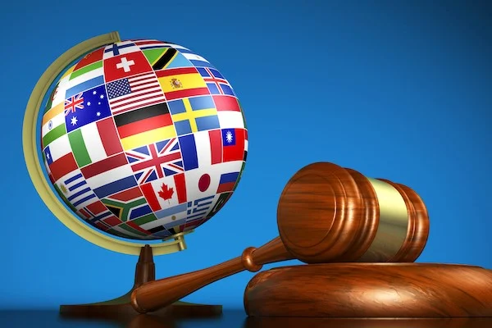
International Law
International law regulates relations between countries, covering trade, diplomacy, human rights, and conflict resolution.
It helps maintain global peace, facilitates international cooperation, and ensures that countries follow treaties and agreements.

Slide 72

Privacy Law
Privacy law protects individuals’ personal information from misuse by governments, businesses, and hackers.
It ensures data security in areas like healthcare, finance, and social media, balancing public safety with personal rights.

